Slide 1
CS4048 Data Science
Lecture – 10

Slide 2

Data Cleaning – Identify and Remove Outliers
The Z-score is a statistical measure that quantifies how far a particular data point is from the mean of a dataset in terms of standard deviations. It's a commonly used method for detecting outliers in a dataset
Define a threshold or criterion for what constitutes an outlier. Commonly used thresholds include 2 standard deviations (Z<=-2 or Z>=2) or 3 standard deviations (Z<=-3 or Z>=3 or ) from the mean
Data points with Z-scores that exceed the defined threshold are considered outliers

Slide 3

Data Cleaning – Identify and Remove Outliers

Slide 4
Data Cleaning – Identify and Remove Outliers
IQR (Inter Quartile Range)
The quartiles of a data set divide the data set into the following four parts, each containing 25% of the data:
The first quartile (Q1) is the 25th percentile
The second quartile (Q2) is the 50th percentile, that is, the median.
The third quartile (Q3) is the 75th percentile
The IQR is a measure of variability, much more robust than the SD may be interpreted to represent the spread of the middle 50% of the data
IQR = Q3 − Q1
A data value is an outlier if:
it is located 1.5(IQR) below the first quartile Q1 i.e., Q1-(1.5*IQR), or
it is located 1.5(IQR) above the third quartile Q3 i.e., Q3+(1.5*IQR)

Slide 5
Data Cleaning – Identify and Remove Outliers
Suppose you have a dataset of exam scores: [65, 72, 75, 78, 80, 81, 82, 85, 90, 110].
Calculate Quartiles:
Q1 = 75 (since it's the 25th percentile)
Q3 = 85 (since it's the 75th percentile)
Calculate IQR:
IQR = Q3 - Q1 = 85 - 75 = 10.
Define a Threshold:
Threshold = 1.5 * IQR = 1.5 * 10 = 15.
Identify Outliers:
Any data point below Q1 - Threshold = 75 - 15 = 60 or above Q3 + Threshold = 85 + 15 = 100 is considered an outlier.
In this example, the data point 110 is above the upper threshold and is therefore considered as an outlier.
Notes:
Q2= (80+81)/2=80.5
LH data = {65,72,75,78,80} -> median -> Q1=75
UH data= {81,82,85,90,110}-> median -> Q3 =85
IQR = Q3-Q1=85 – 75 =10

Slide 6
Data Integration
Data integration is combining data from sources/systems to form a data store
Issues in Data Integration:
Schema Integration
Integrate metadata from different sources
Detecting and resolving data value conflicts
For the same real world entity, attribute values from different sources are different e.g., different representations, different scales, e.g., metric vs. British units

Slide 7
Data Integration
Redundancy
Redundant data occur often when integration of multiple databases
Object identification: The same attribute or object may have different names in different databases
Derivable data: One attribute may be a “derived” attribute in another table, e.g., annual revenue
Redundant attributes may be able to be detected by correlation analysis and covariance analysis
Careful integration of the data from multiple sources may help reduce/avoid redundancies and inconsistencies and improve mining speed and quality

Slide 8
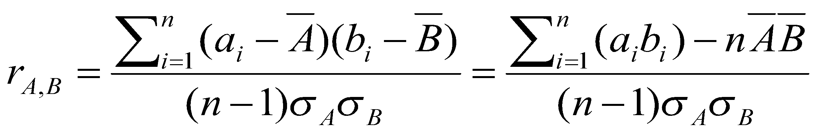


Data Integration
Correlation Analysis
Correlation coefficient (also called Pearson’s product moment coefficient)
where n is the number of tuples, and are the respective means of A and B, σ_{A} and σ_{B} are the respective standard deviation of A and B, and Σ(a_{i}b_{i}) is the sum of the AB cross-product.
If r_{A,B} > 0, A and B are positively correlated (A’s values increase as B’s). The higher, the stronger correlation.
r_{A,B} = 0: independent
r_{AB} < 0: negatively correlated

Slide 9
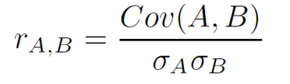
Data Integration
Covariance Analysis
Covariance is similar to correlation

Slide 10
Data Integration
Positive covariance: If Cov_{A,B} > 0, then A and B both tend to be larger than their expected values.
Negative covariance: If Cov_{A,B} < 0 then if A is larger than its expected value, B is likely to be smaller than its expected value.
Independence: Cov_{A,B} = 0 but the converse is not true:
Some pairs of random variables may have a covariance of 0 but are not independent. Only under some additional assumptions (e.g., the data follow multivariate normal distributions: all dependencies are linear) does a covariance of 0 imply independence For example: 𝐘 = 𝐗²

Slide 11
Data Integration
Suppose two stocks A and B have the following values in one week:
(2, 5), (3, 8), (5, 10), (4, 11), (6, 14).
Question: If the stocks are affected by the same industry trends, will their prices rise or fall together?
E(A) = (2 + 3 + 5 + 4 + 6)/ 5 = 20/5 = 4
E(B) = (5 + 8 + 10 + 11 + 14) /5 = 48/5 = 9.6
Cov(A,B) = ((2×5+3×8+5×10+4×11+6×14)/5) − 5(4 × 9.6)/5 = 4
Correlation coef = 4/(std of A * std of B)
Thus, A and B rise together since Cov(A, B) > 0.

Slide 12




Coefficient of Determination

Slide 13

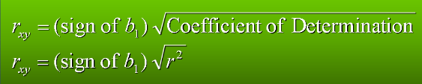
Correlation Coefficient

Slide 14
Data Reduction
Obtain a reduced representation of the data set that is much smaller in volume but yet produces the same (or almost the same) analytical results while maintain the data integrity
Why data reduction? — A database/data warehouse may store terabytes of data. Complex data analysis may take a very long time to run on the complete data set.

Slide 15
Data Reduction
Data reduction strategies include:
Dimensionality reduction, e.g., remove unimportant attributes/redundancy in data
Wavelet transforms
Principal Components Analysis (PCA)
Feature subset selection, feature creation
Numerosity reduction, data is replaced by estimated/alternative value
Regression and Log-Linear Models
Histograms, clustering, sampling
Data cube aggregation
Data compression, using encoding of data

Slide 16
Data Transformation
It is preprocessing technique in which attribute values are mapped to a new set of values. When multiple attributes are having values on different scales this may lead to poor data models. Due to this reason, data normalization is performed to bring all attributes on same scale.
Methods
Smoothing: Remove noise from data (binning, regression, clustering)
Attribute/feature construction
New attributes constructed from the given ones
Aggregation: Summarization, data cube construction
Normalization: Scaled to fall within a smaller, specified range
min-max normalization
z-score normalization
normalization by decimal scaling

Slide 17


Data Transformation
Min-Max Normalization:
Ex. Let income range $12,000 to $98,000 normalized to [0.0, 1.0]. Then $73,000 is mapped to ???
Normalization by decimal scaling
Where j is the no. of digits in v
Where j is the no. of digits in maximum absolute value of v (if v is series)
Notes:
0.716

Slide 18
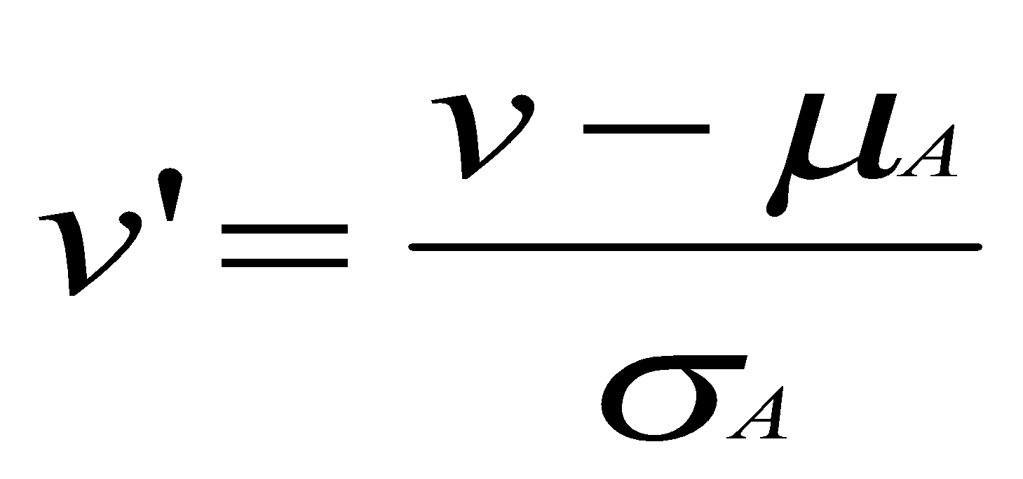
Data Transformation
Z-score normalization (μ: mean, σ: standard deviation):
The resulting value (Z) represents how many standard deviations the data point is away from the mean. A positive Z-score indicates that the data point is above the mean, while a negative Z-score indicates that it is below the mean.
Z-score normalization assumes that your data follows a roughly normal distribution. If your data is strongly skewed or has outliers, you may need to consider other normalization or transformation techniques.

Slide 19

Data Transformation
Modified Z-Score Normalization:
In cases where your data has outliers that might significantly affect the mean and standard deviation, modified version of Z-score normalization is used
Instead of the sample standard deviation (σ), you use a robust estimate of the scale, such as the median absolute deviation (MAD)

Slide 20
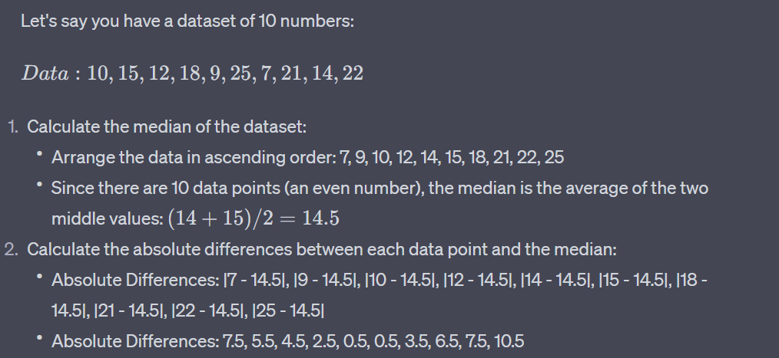
Data Transformation

Slide 21
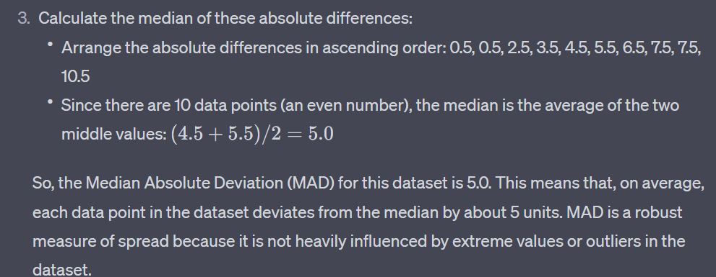
Data Transformation

Slide 22
Data Discretization
Three types of attributes
Nominal—values from an unordered set, e.g., color, profession
Ordinal—values from an ordered set, e.g., military or academic rank
Numeric—real numbers, e.g., integer or real numbers
Discretization: Divide the range of a continuous attribute into intervals
Interval labels can then be used to replace actual data values
Reduce data size by discretization
Supervised vs. unsupervised
Split (top-down) vs. merge (bottom-up)
Discretization can be performed recursively on an attribute
Prepare for further analysis, e.g., classification

Slide 23
Data Discretization Methods
Typical methods: All the methods can be applied recursively
Binning
Top-down split, unsupervised
Histogram analysis
Top-down split, unsupervised
Clustering analysis (unsupervised, top-down split or bottom-up merge)
Decision-tree analysis (supervised, top-down split)
Correlation (e.g., χ²) analysis (unsupervised, bottom-up merge)
Notes:
‹#›

Slide 24
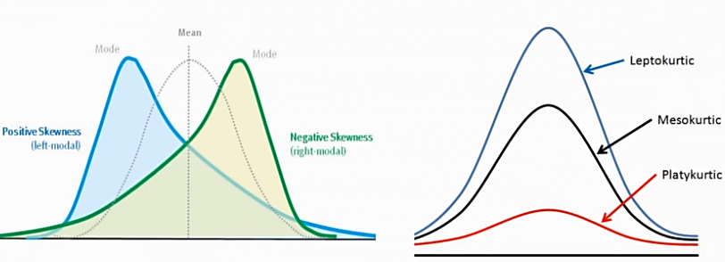
Kurtosis
A measure of peakedness relative to a Gaussian shape

Slide 25
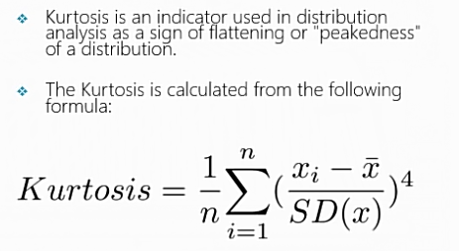
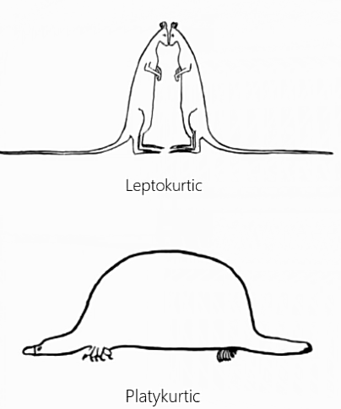
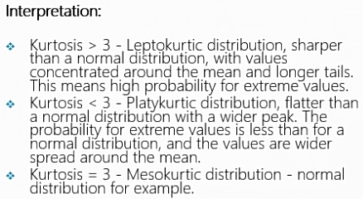
Kurtosis

Slide 26
Exploratory Data Analysis
The primary purpose for the EDA is to better understand the data we are using, how to transform the data, if necessary, and how to assess limitations and underlying assumptions inherent in the data structure
Data scientists need to know how the various pieces of data fit together in order to decide what is the best approach to model the task
Any type of method to look at data that does not include formal statistical modeling and inference generally falls under the EDA

Slide 27
EDA
Here are some of the main reasons why we utilize EDA:
Detection of mistakes.
Checking of assumptions.
Preliminary selection of appropriate models and tools.
Determining relationships of the explanatory variables (independent).
Detecting the direction and size of relationships between variables.

Slide 28
EDA
In data exploration, generally we focus on:
Summary statistics
Descriptive Statistics : Measures of Location and Spread
Visualization
Histogram
BOX plot
Scatter Plot

Slide 29
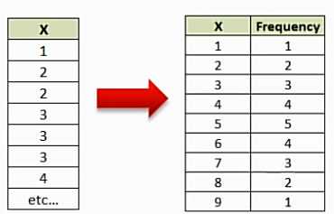
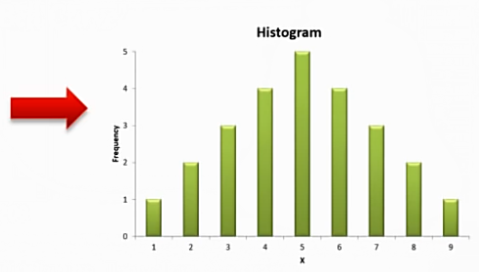
Histograms
Histogram is a bar chart that groups numbers into ranges or bins
Histograms displays data using bars of different heights allowing us to evaluate the shape of the underlying distribution

Slide 30
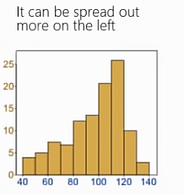
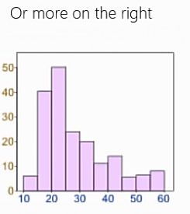
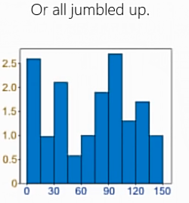
Histograms
Data can be distributed (spread out) in many different ways. It can be spread out more on the left Or more on the right Or all jumbled up.

Slide 31
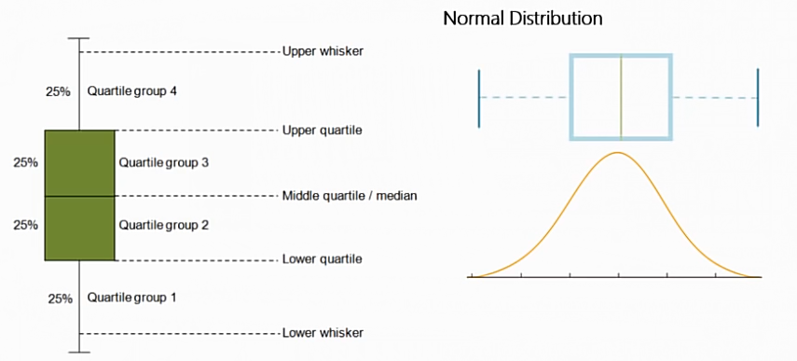
Box Plot
A Boxplot is a nice way to graphically represent the data in order to communicate the data through their quartiles.

Slide 32
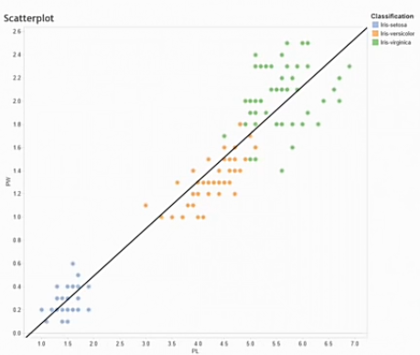
Scatter Plots
A point plot between two variables used to understand the spread of the data.
The spread of the data allows
for us to understand if the data has
a non-linear or linear relationship
and the relative degree of the
correlation in the data.
This technique can allow be used to
detect outliers in the data.
A scatterplot becomes more powerful
when you incorporate categorical
data as an additional dimension.

Slide 33
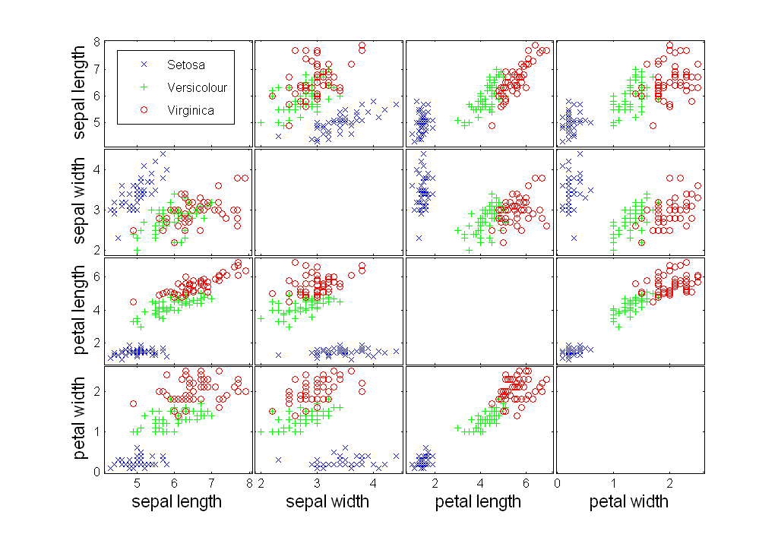
Scatter Plot

Slide 34
Heat Maps
A heat map is the visualization of data that represents the magnitude of a value in a color code ranging from minor to major intensity
Heat maps are valuable tools for exploring and understanding complex data sets. They help in identifying patterns, outliers, correlations, and trends that might not be apparent when examining raw data.
There are two main types of heatmaps:
The Spatial Heat Map: Represented with a canvas that represents a two-dimensional space; it can be a geographical map, a web page, or other cartesian representation.
Grid/Matrix Heat Map: This type of heat map displays the magnitude of a phenomenon using a two-dimensional matrix. Columns and Rows categorize a cell (the location) and the cell’s color code defines the phenomenon’s value intensity.

Slide 35
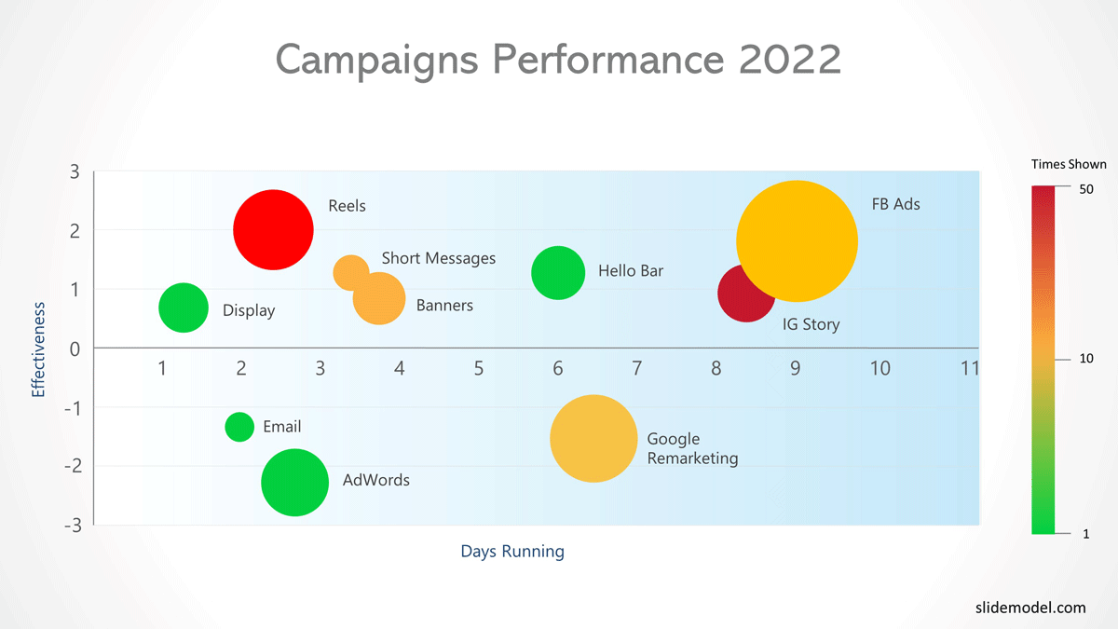
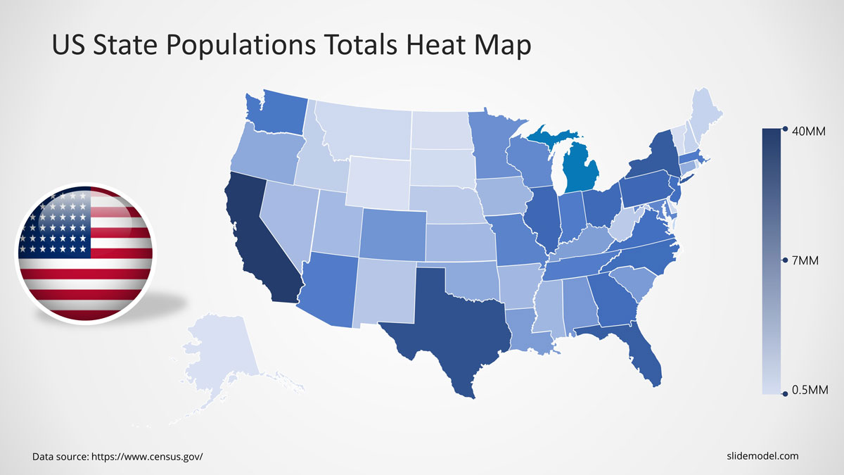
Spatial Heat Map

Slide 36
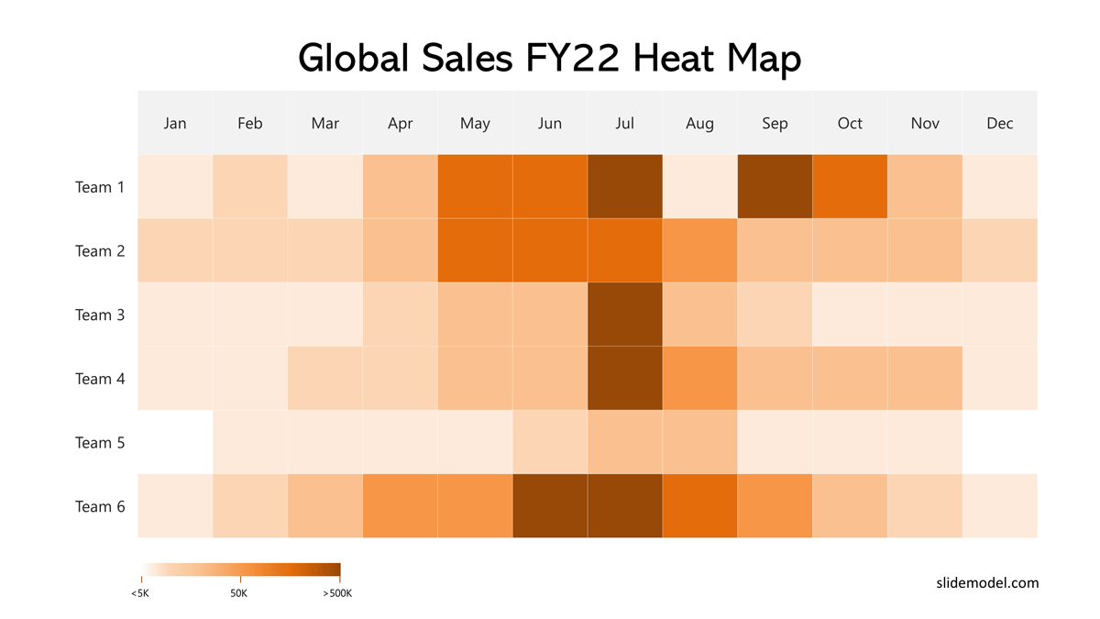
Matrix Heat Map

Slide 37
Sample Example On Google Colab
The Jupyter notebook will be shared on GoogleClassroom

